Slide 1

Engineering, Hydrology and Geology
DAM, EMBANKMENT AND LEVEE SAFETY FEATURES,
EMBANKED STORMWATER PONDS

Slide 2
Inventory of Dams
In the U.S.A.:
– 79,000 Dams
  57,000 Dams have inadequate protection against
overtopping
  3,500 Structurally Unsafe Dams (Actual Number Considered to be much Higher)
  ASCE 2005 Report Card on US Infrastructure:
    Dams received a “D”
    More than ¼ older than 50 years
    $10.1 Billion needed to rehab critical non-federal dams that pose a direct risk to human life.

Slide 3
Inventory of Dams Continued
In Florida:
  National Inventory shows 796 entries
  FDEP preliminary count shows >4000
  Much of infrastructure associated with dams, levees, and reservoirs is 50 years or older
  Comprehensive inventory and assessment needed

Slide 4
Causes of Dam Failures
Seepage and soil piping
Overtopping
Spillways and other outlets
Slope instability
  Steep Slopes
  Poor Selection of Materials
  Inadequate Placement and Compaction
  Lack of Positive Seepage Control
  Weak Foundation

Slide 5
Dams in Florida—Geologic Considerations
Relatively flat topography
  Maximum height for “natural” dams approximately 50 feet
  Maximum height for “impoundments” exceeds 100 feet
(tailings dams, gypsum stacks)
Unique geologic setting
  Relief created by sand ridges and wave-carved escarpments
  Primary construction material is sand
  Lots of unsuitable materials (organic soils, soft clay, uniform fine sands)
  Rock exposures uncommon

Slide 6
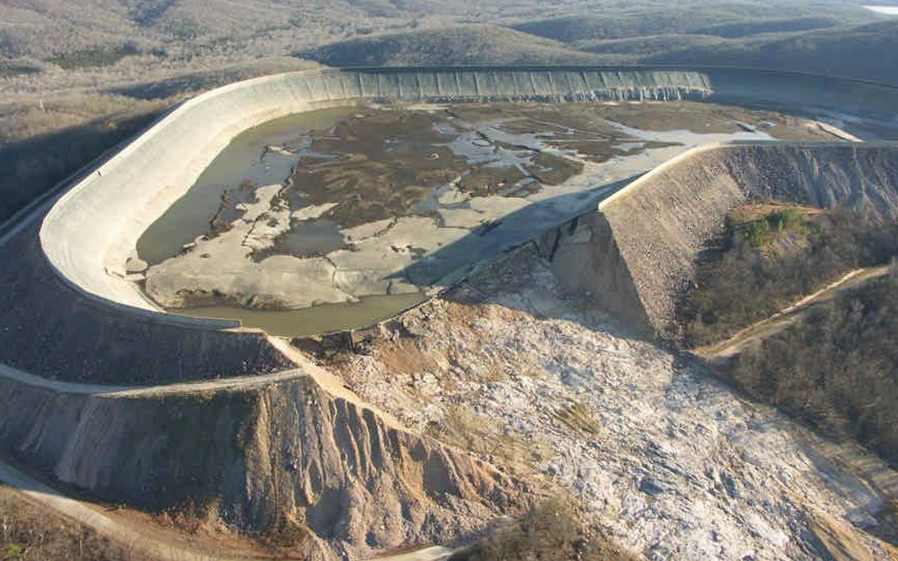


How and Why Dams Fail

Slide 7
Causes of Dam Incidents
Fundamental Causes Percentage Sabotage. 0....... Earthquake Instability 1....... Faulty Construction. 2....... Gate Failure. 2.......
Sliding. 10.......
Deformation. 11.......
Overtopping 25.......
Seepage/Piping 35.......
75%
7

Slide 8

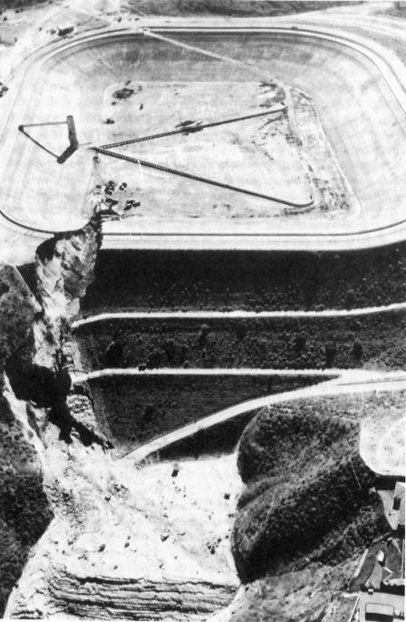


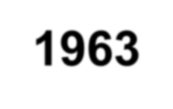




Baldwin Hills Dam, Los Angeles - 1963
Catastrophic Failure Within 4.5 Hours of Observation
Problems noted at 12:20 p.m.
Evacuation Began at 1:00 p.m.
Helicopters With Speakers
1,600 People Evacuated by
3:20
Dam Failed at 3:38 p.m.
41 Homes Destroyed
1,000 Homes Damaged
5 People Drowned
Reservoir Empty by 4:55 p.m.
232 Feet High

Slide 9

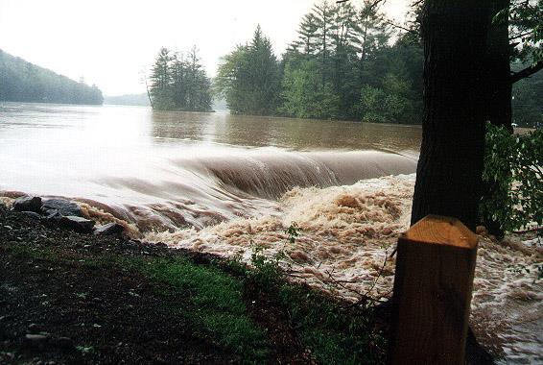
Failure By Overtopping

Slide 10
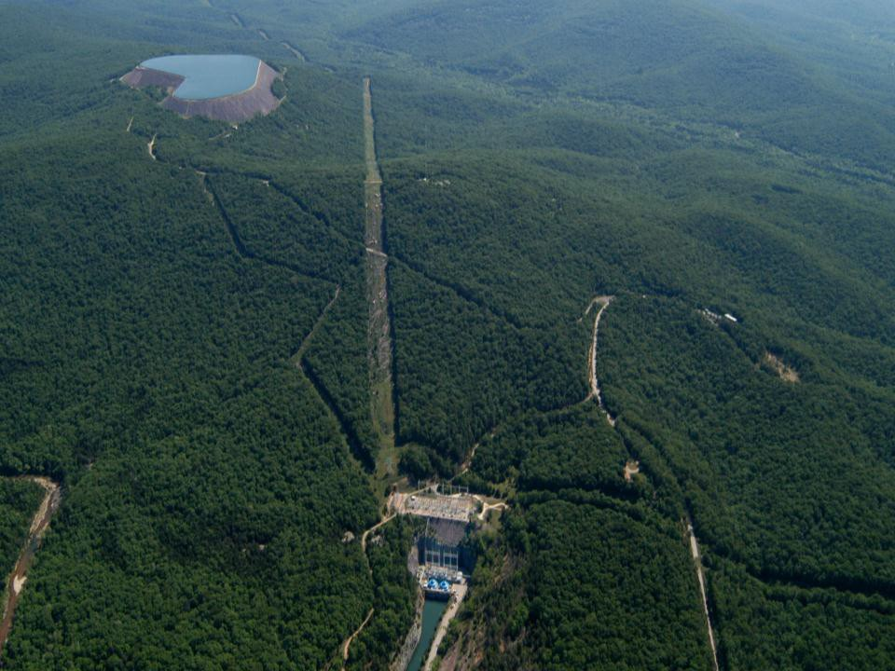
Taum Sauk, 2005

Slide 11
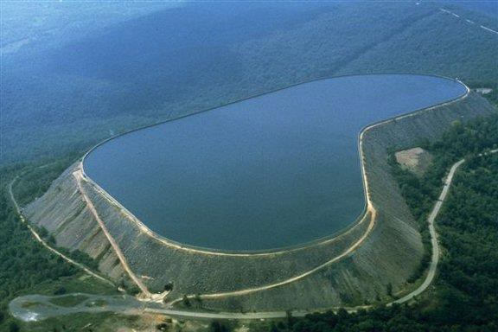



Taum Sauk Dam Failure, Reynolds County, Missouri
December 14, 2005
Source: AmerenUE

Slide 12
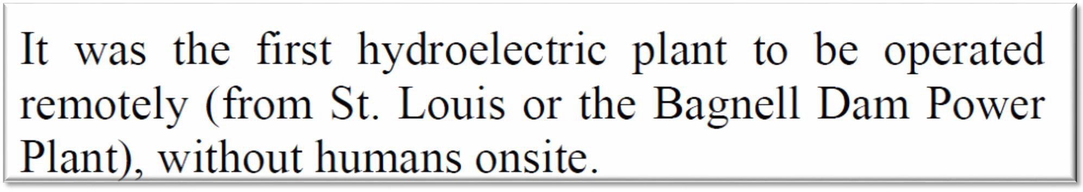
Taum Sauk, 2005

Slide 13
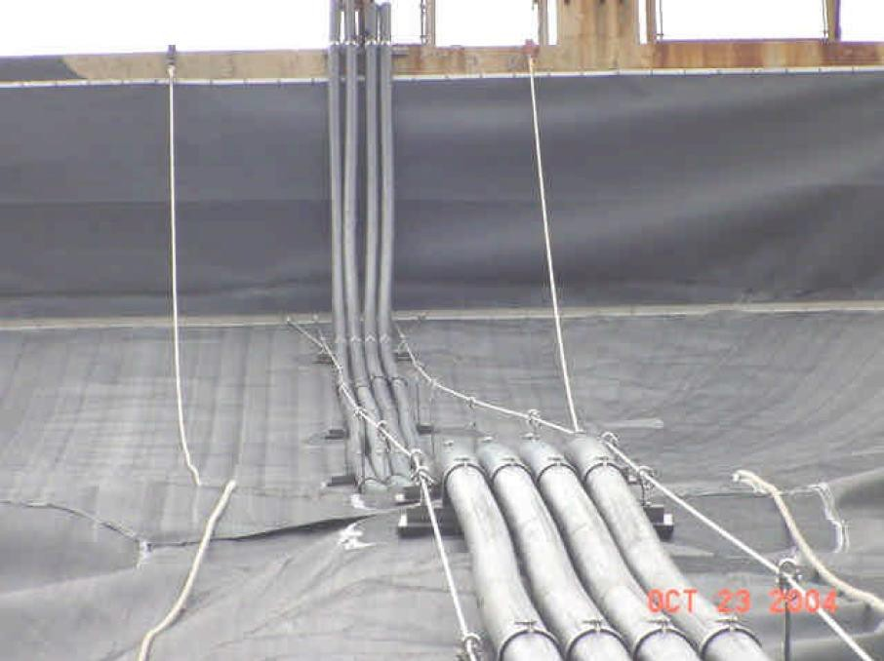
Source: Paul Rizzo & Associates Report
UNISTRUT ASSEMBLY

Slide 14
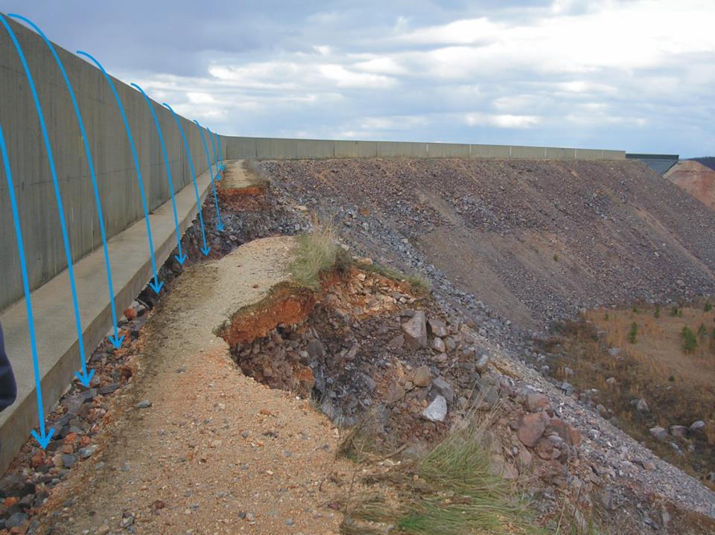


Photo by David Hoffman

Slide 15
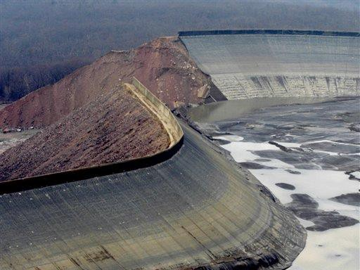

Slide 16
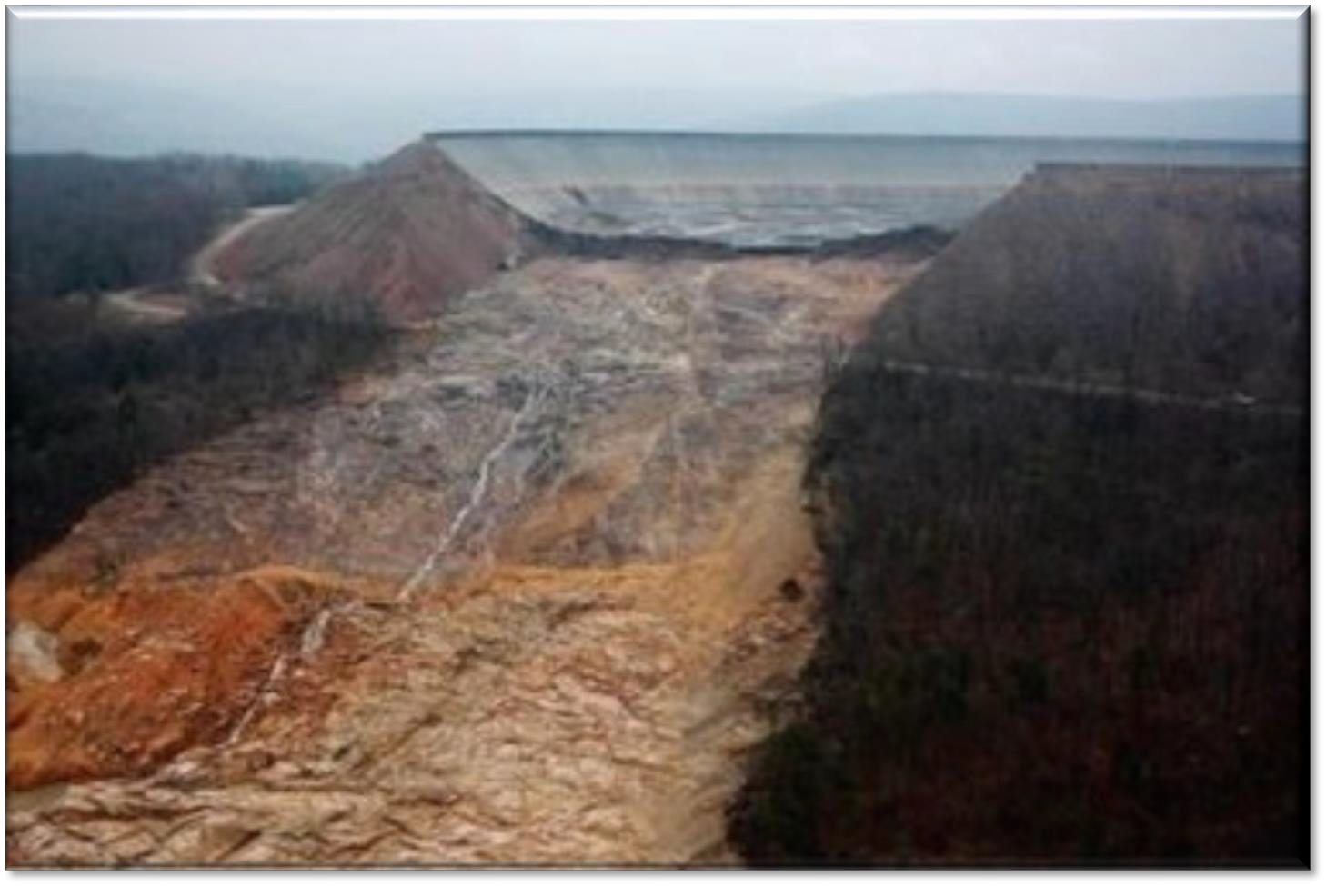
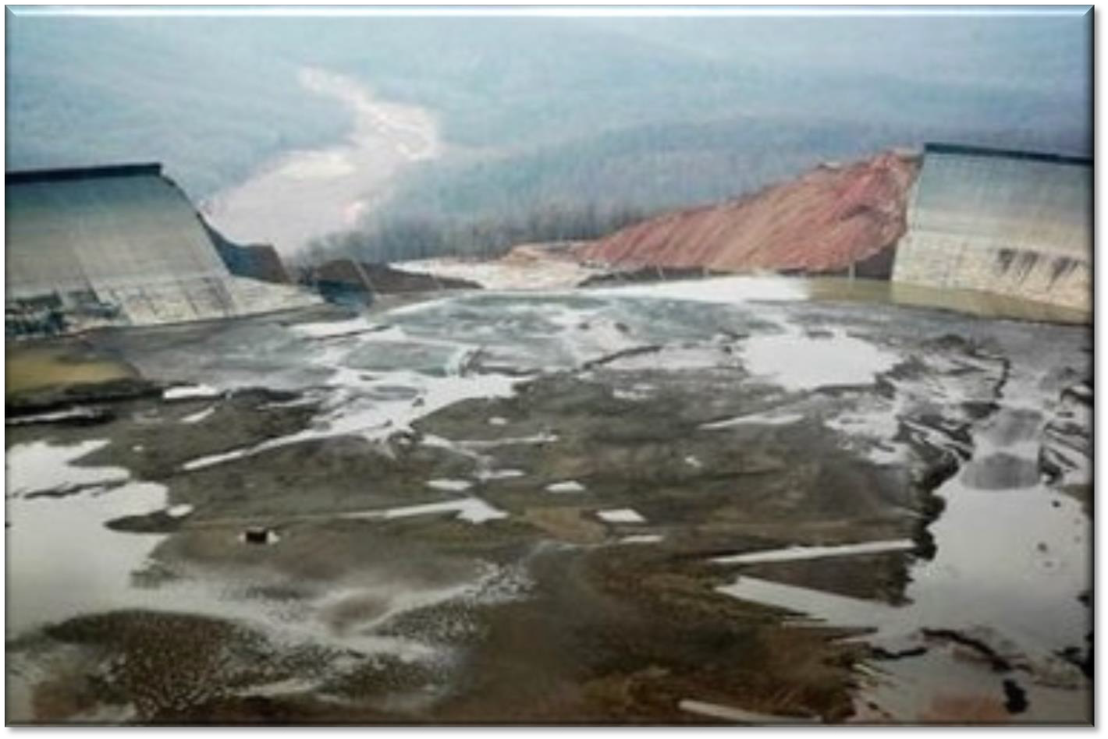

Slide 17


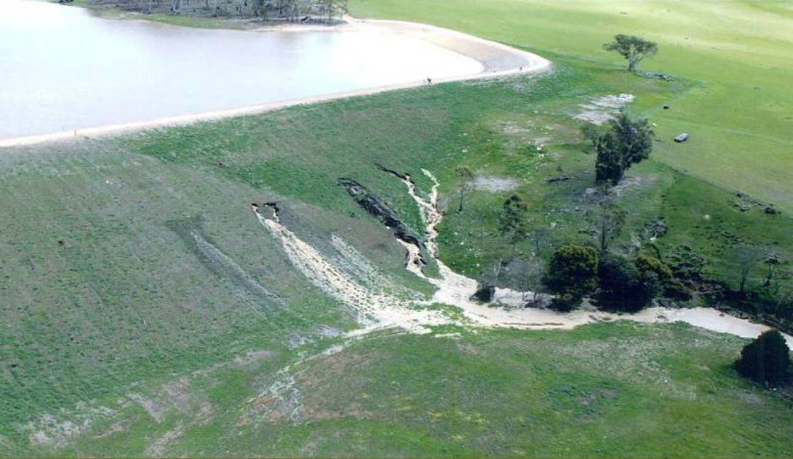
Failure By Uncontrolled Seepage

Slide 18

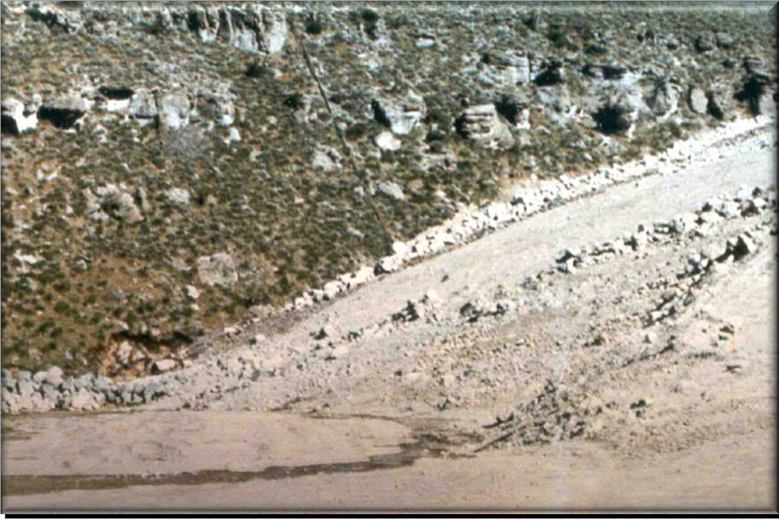
Teton Dam
June 5, 1976
Clear Water Springs from Joints
In Rock
Hydropower Plant

Slide 19

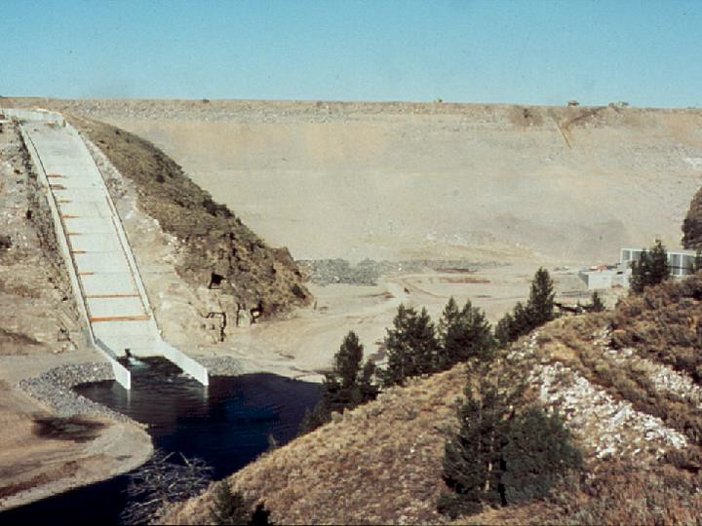
Teton Dam
June 5, 1976
Muddy Seepage Observed at Right
Abutment 8:30 a.m.

Slide 20
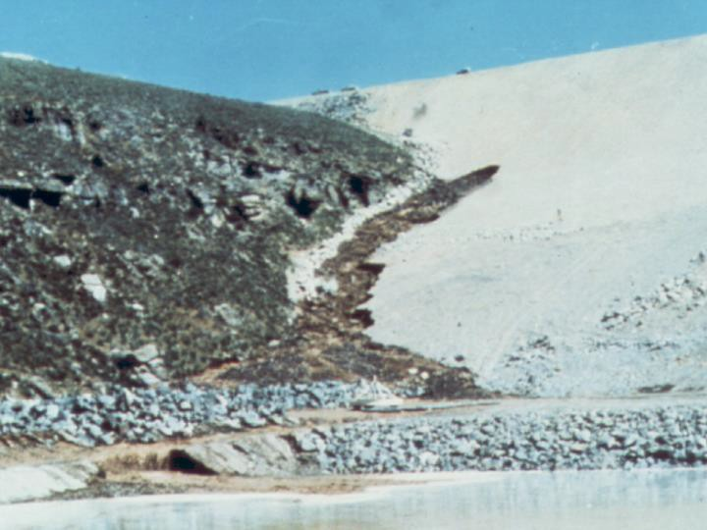
June 5, 1976
10:45 a.m.

Slide 21
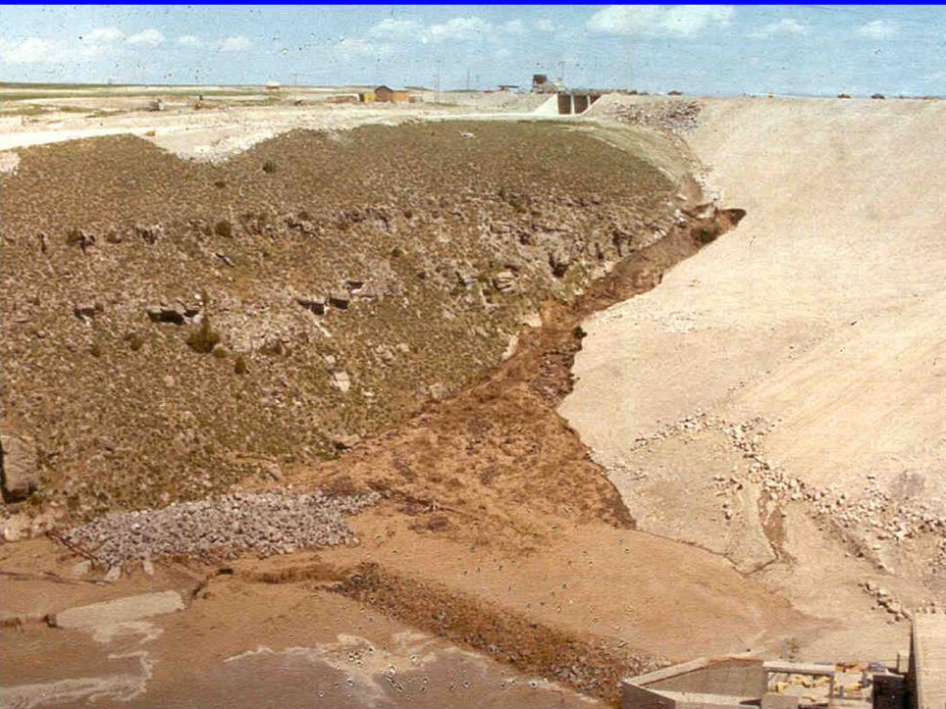

Slide 22
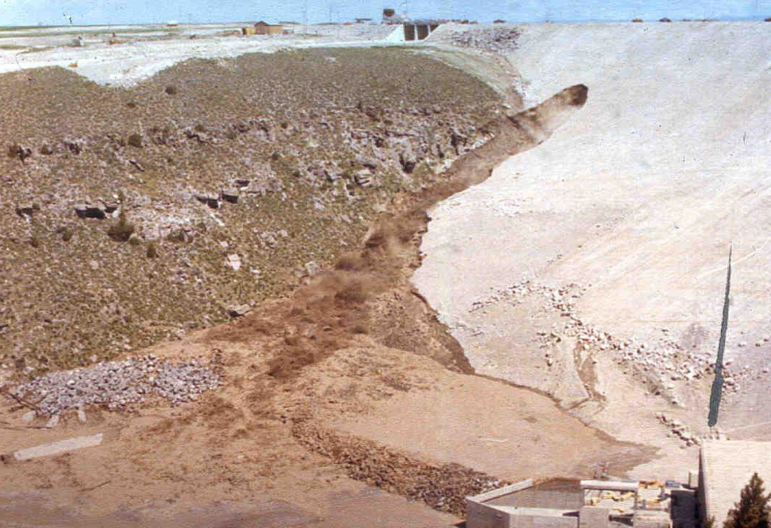

Slide 23
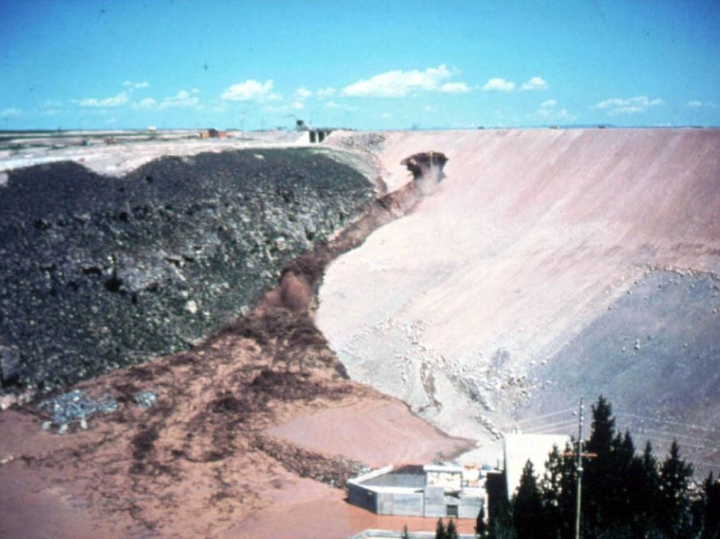
11:20 a.m. Large Vortex Observed In Reservoir

Slide 24
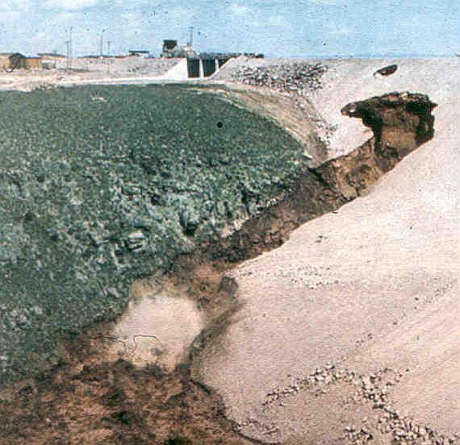

Slide 25
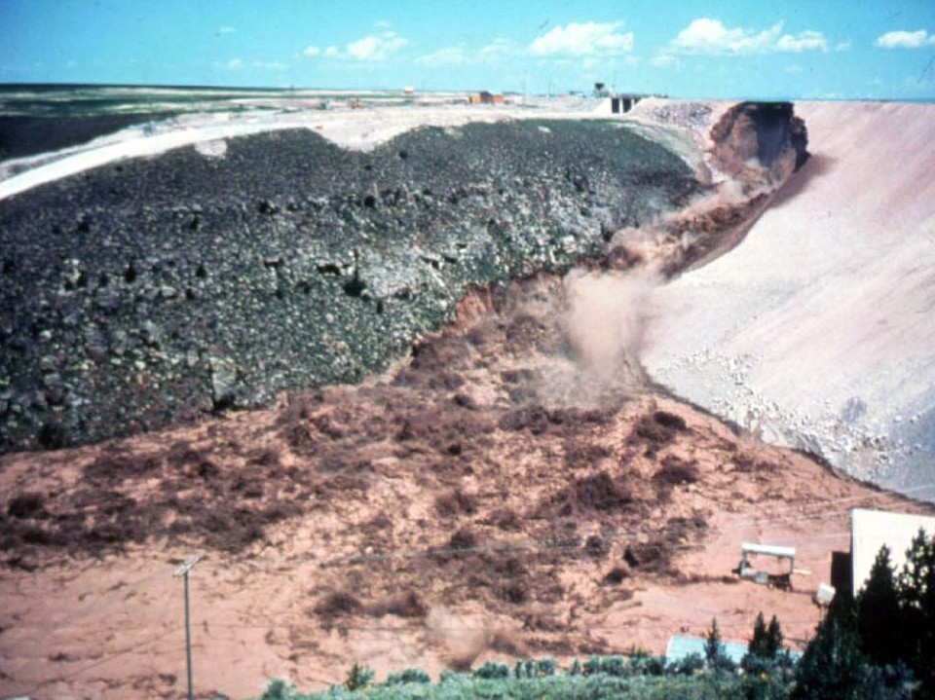

Slide 26
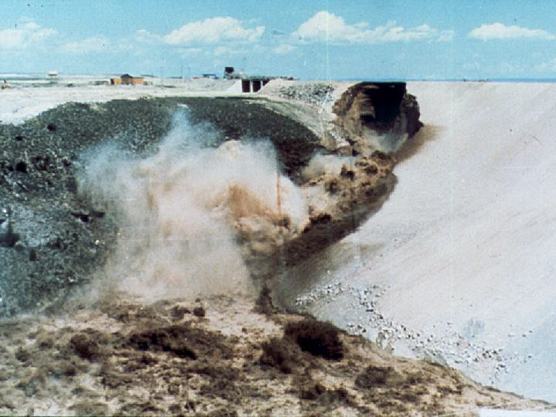
Dam Crest Breaching, 11:55 a.m.

Slide 27
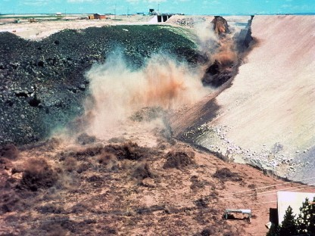

Slide 28
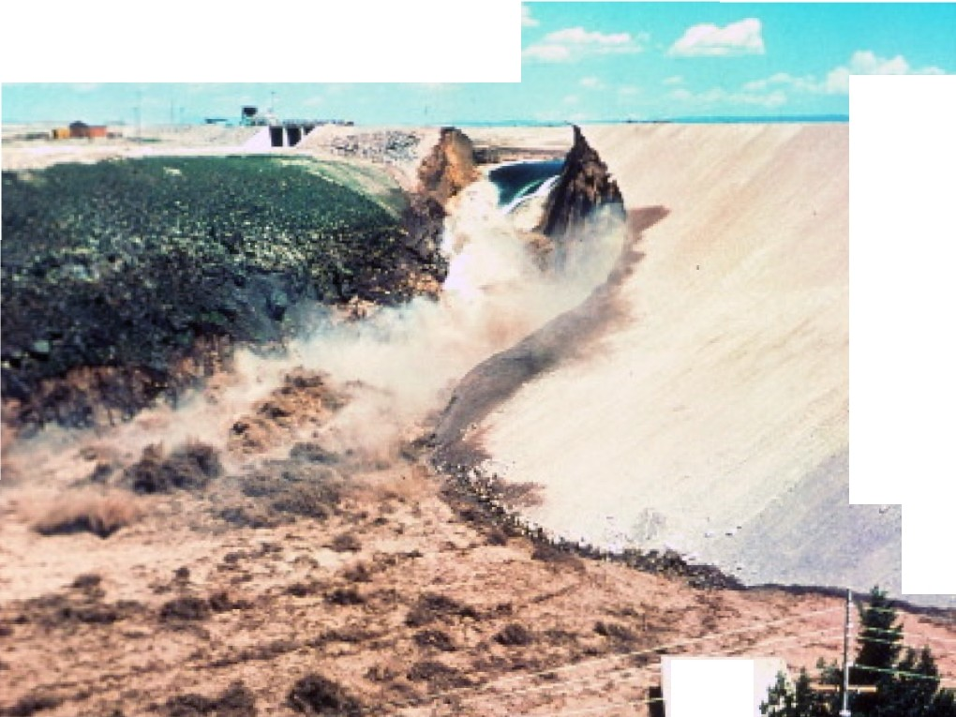
••
•
•
..
••

Slide 29
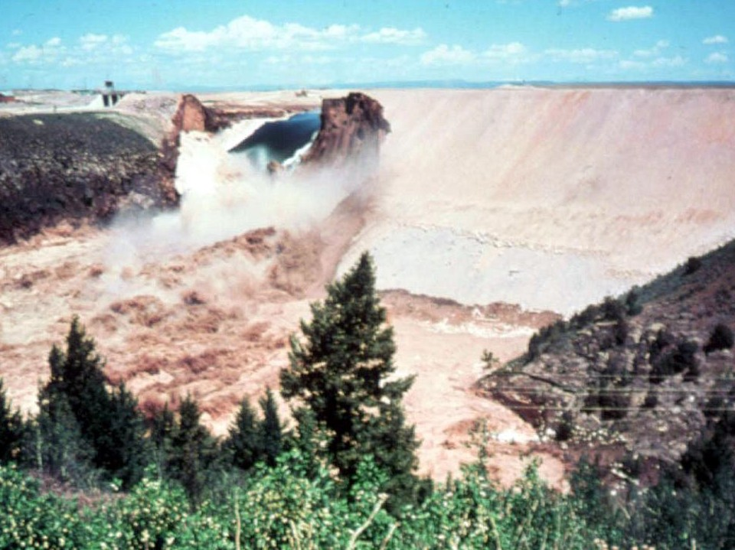

Slide 30
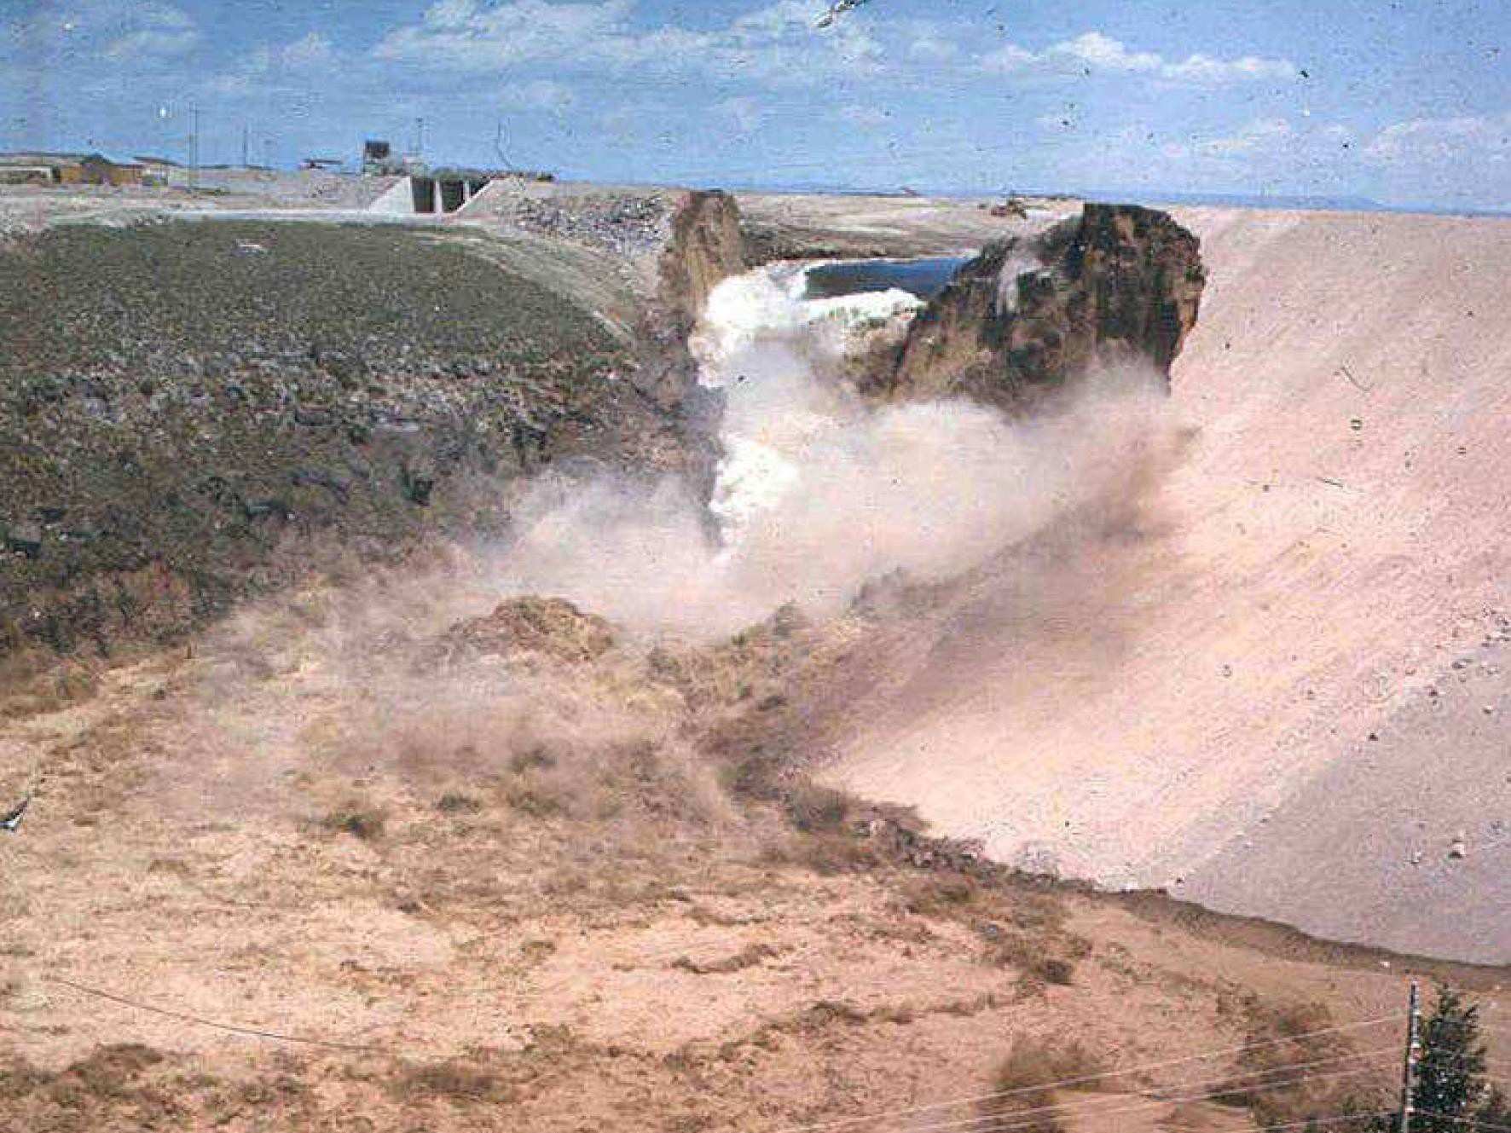

Slide 31
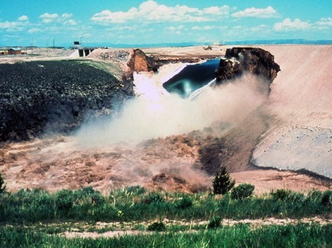

Slide 32
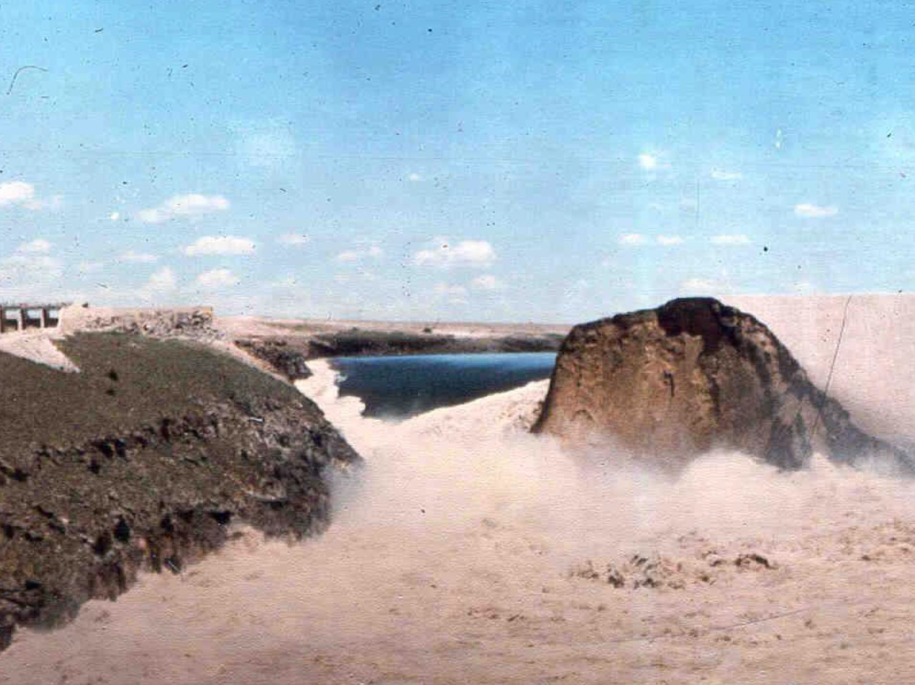
Early Afternoon

Slide 33
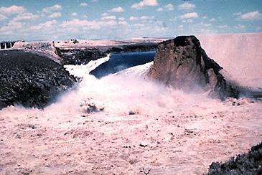
Early Afternoon

Slide 34
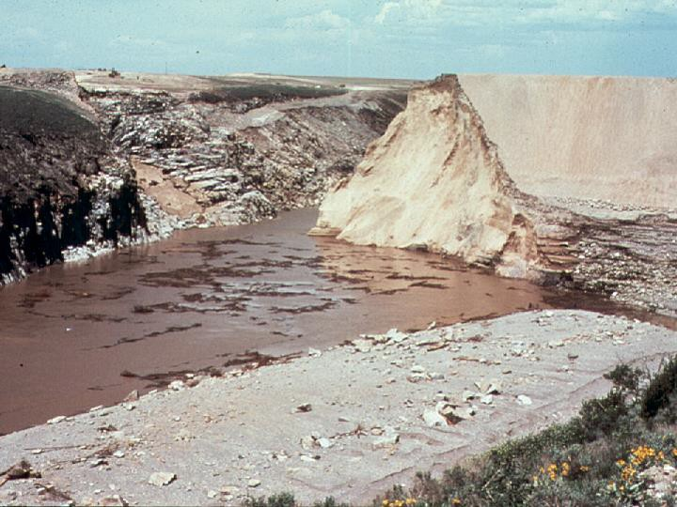
Late Afternoon

Slide 35
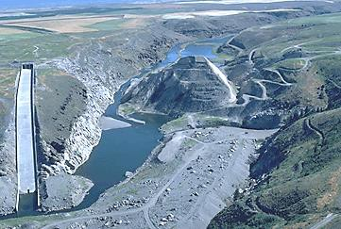

Slide 36
Topics to Discuss
1928 Hurricane and Lake O Dike Failure
Current Condition of Herbert Hoover Dike
Hurricane Katrina—Levee Failures
Independent Review of HHD
CERP Reservoirs
Pensacola Dam Failure

Slide 37
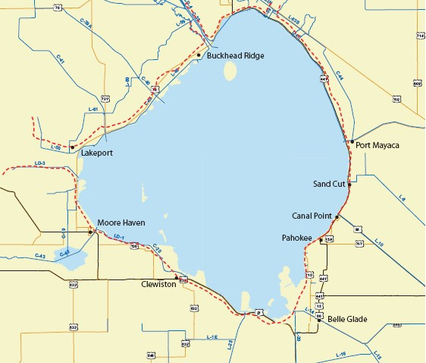
Lake Okeechobee
970 square miles in natural state
Before drainage projects, when lake reached ~Elev. 21 ft. water overflowed a low natural levee at South end into the Everglades

Slide 38
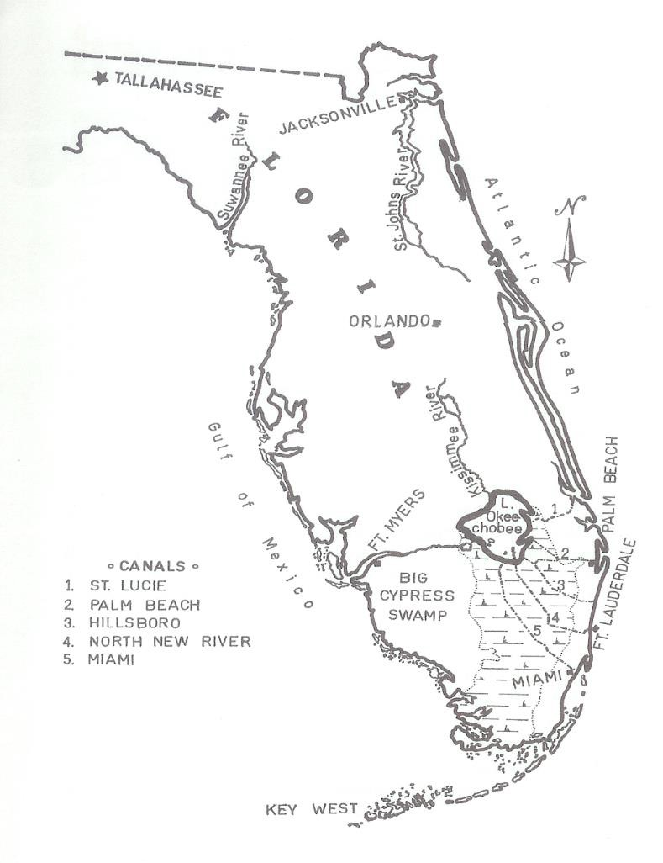
Lake Okeechobee
Drainage and reclamation projects began with Hamilton Disston in 1860’s.
In early 1900’s, Governor Napoleon Bonaparte Broward was elected on platform to aggressively drain the Everglades.
By 1920, six canals dug that lowered the Lake by 6 feet and reduced its area by 250 sq. miles.

Slide 39
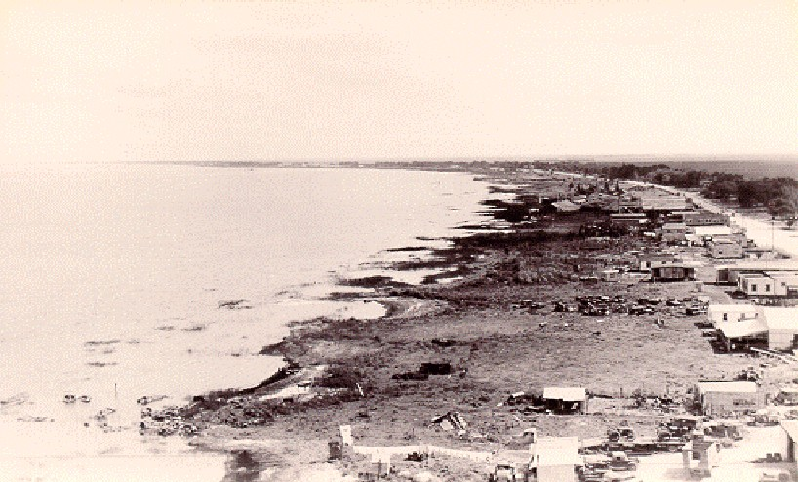
Pahokee – Before the Dike

Slide 40
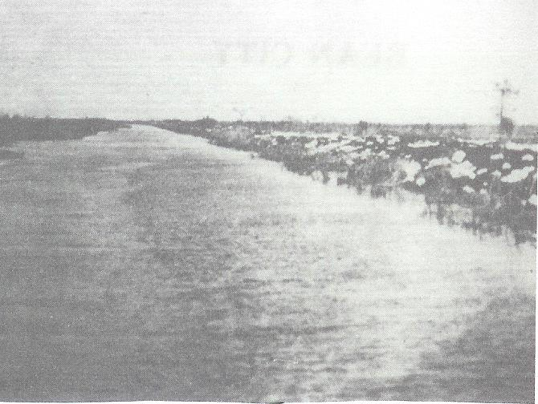
Lake Okeechobee Muck Dike
Beginning in 1923, EDD build earthen dike 57 miles long from Moore Haven to Pahokee using hopper dredges.
– Dike ranged in height
from 5 to 9 feet
Constructed from locally dredged material, including muck
Where dike crossed dead rivers, loose silt was dredged as fill
Settlement and slumping required re-dredging several times
5/20/2014
40

Slide 41
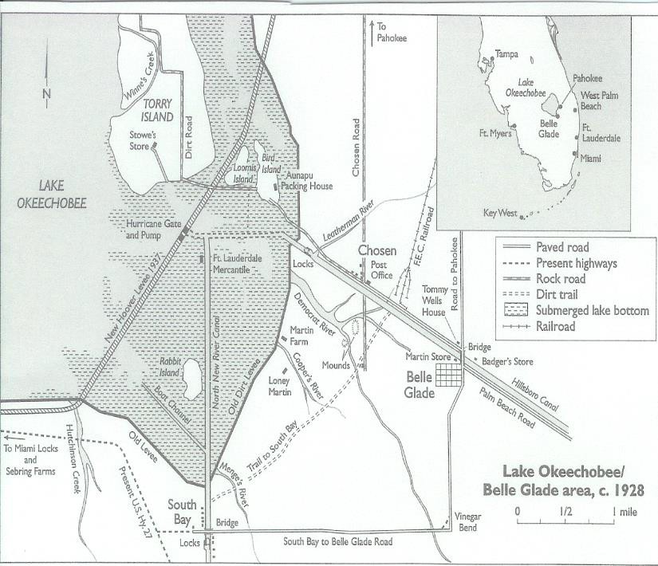
Prelude to Disaster
Protection from flooding brought new surge of settlers. From less than 100 settlers in 1915, lake area by 1928 had
increased to more than 6000.
Many from Broward/Dade, where economy had
collapsed following1926
hurricane.
1926 hurricane spared south side of lake, but wind tides and rains caused overtopping of dike on western shore, killing approximately 200 in Moore Haven.
1926 hurricane exposed weakness of muck dike, and plans
were made to build a larger dike.
41

Slide 42
1928 Events
Despite various funding attempts, Florida’s deep depression prevented legislature from funding new projects for the EDD.
In 1928, an early season Cat. 2 hurricane, plus numerous thunderstorms, raised the Lake to within 2 feet of the top of muck dike by mid- September.
Then, as now, outlet works could discharge less than 1 foot of water per month, while inflow could be more than 1 foot per day during major storms.

Slide 43
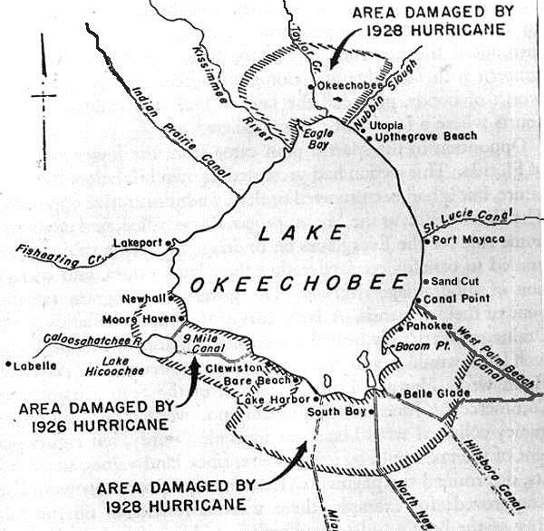
1928 Dike Failure
On September 16, a Cat. 4 hurricane, with 155 mph winds, struck.
Wind tide forced water to height of 8 feet above the dike between South Bay and Pahokee
Dike quickly eroded,
producing massive flood
wave that killed more than 2500 people.
Largest dam catastrophe in U.S. history, exceeding
Johnstown Flood of 1889 (2209 deaths)

Slide 44
1928 Hurricane References
Killer Cane, by Robert Mykle, 2002, Coopers Square Press, NY, NY.
Black Cloud, by Eliot Kleinberg, 2003, Carroll &
Graf Publishers, NY, NY.
Okeechobee Hurricane, by Lawrence E. Will, 1990, 3rd ed., The Glades Historical Society, Belle Glade, FL.
Beyond the Fourth Generation, by Lamar Johnson, 1974, Univ. of FL Press, Gainesville.

Slide 45
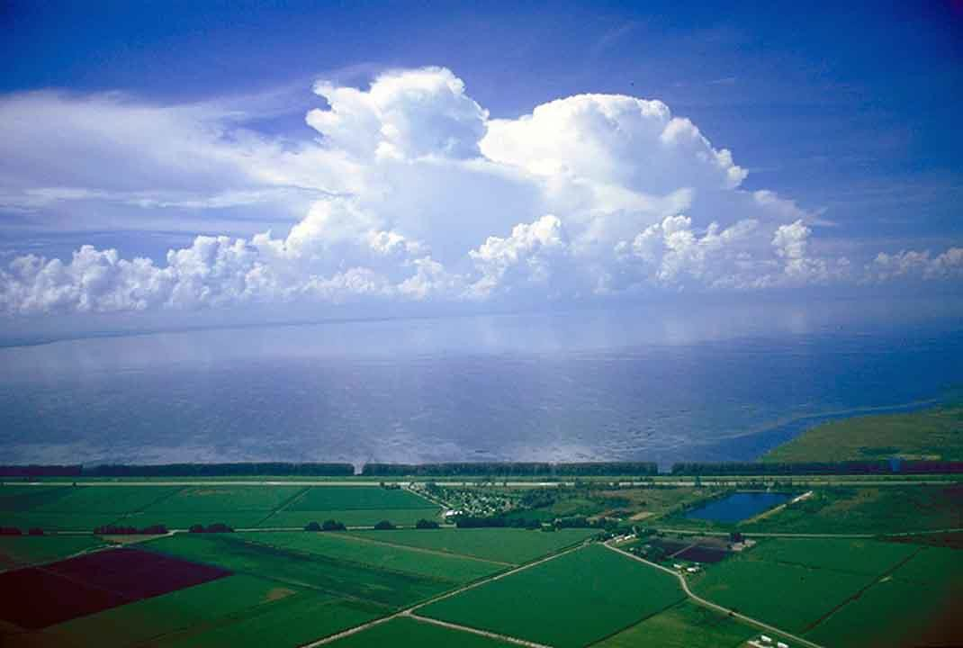
Herbert Hoover Dike

Slide 46
Herbert Hoover Dike
After the disastrous hurricane of 1928, USACE
rebuilt the dike beginning in 1932.
By 1938 the dike encompassed 85 miles from
Moore Haven to Port Myakka.
Following the 1940’s hurricanes, the dike was enlarged and completed around the entire perimeter of 140 miles.
Downstream muck subsidence of 1 inch per year made the dike even more essential for flood control (Note that peat formed over 3000 years at rate of one inch per 33 years).

Slide 47
Herbert Hoover Dike
Constructed using hydraulic dredges and draglines
Fill includes silts, clays, peat, sand, shell, and gravel
Crest ranges in elevation from 33 to 45 feet.
Lake level normally regulated between 15.5 and
17.5 feet.
The side slopes range from 2:1 to 5:1.
Foundation has pervious layers (limestone, shell, clean sands), and cohesive layers (hardpan, sandstone, limestone).
Interior borrow channels and exterior rim ditches expose uninterrupted flow paths from lakeside to landside

Slide 48
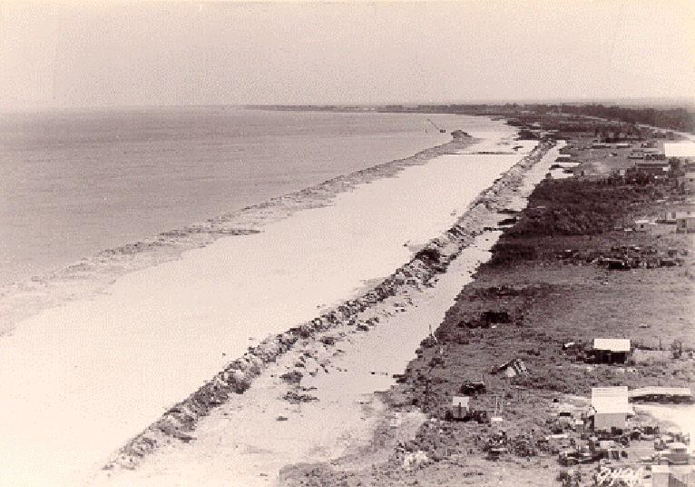
Draglines Constructing
Retaining Dikes

Slide 49
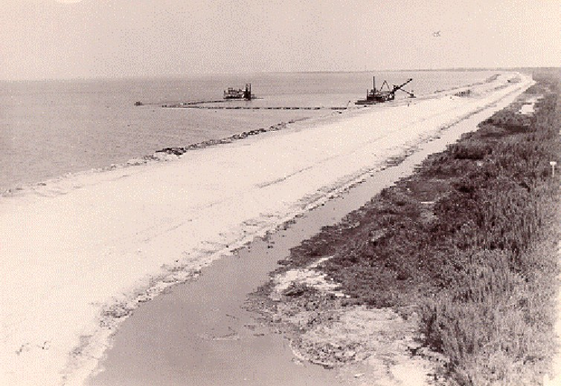
Pipeline Dredge and Dipper
Dredge at Work

Slide 50
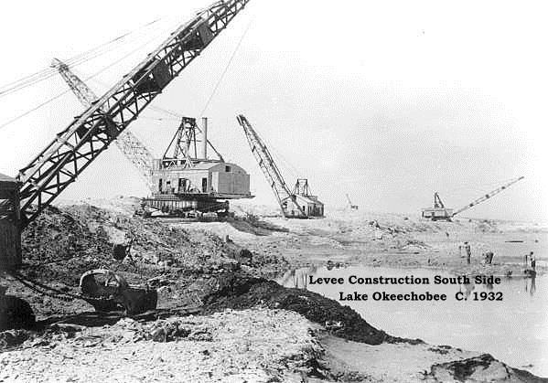
Levee Construction South Side
Lake Okeechobee C. 1932

Slide 51
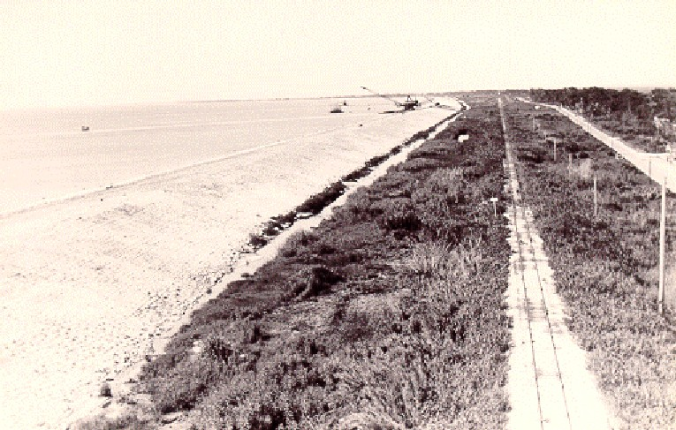
Completed Dam

Slide 52
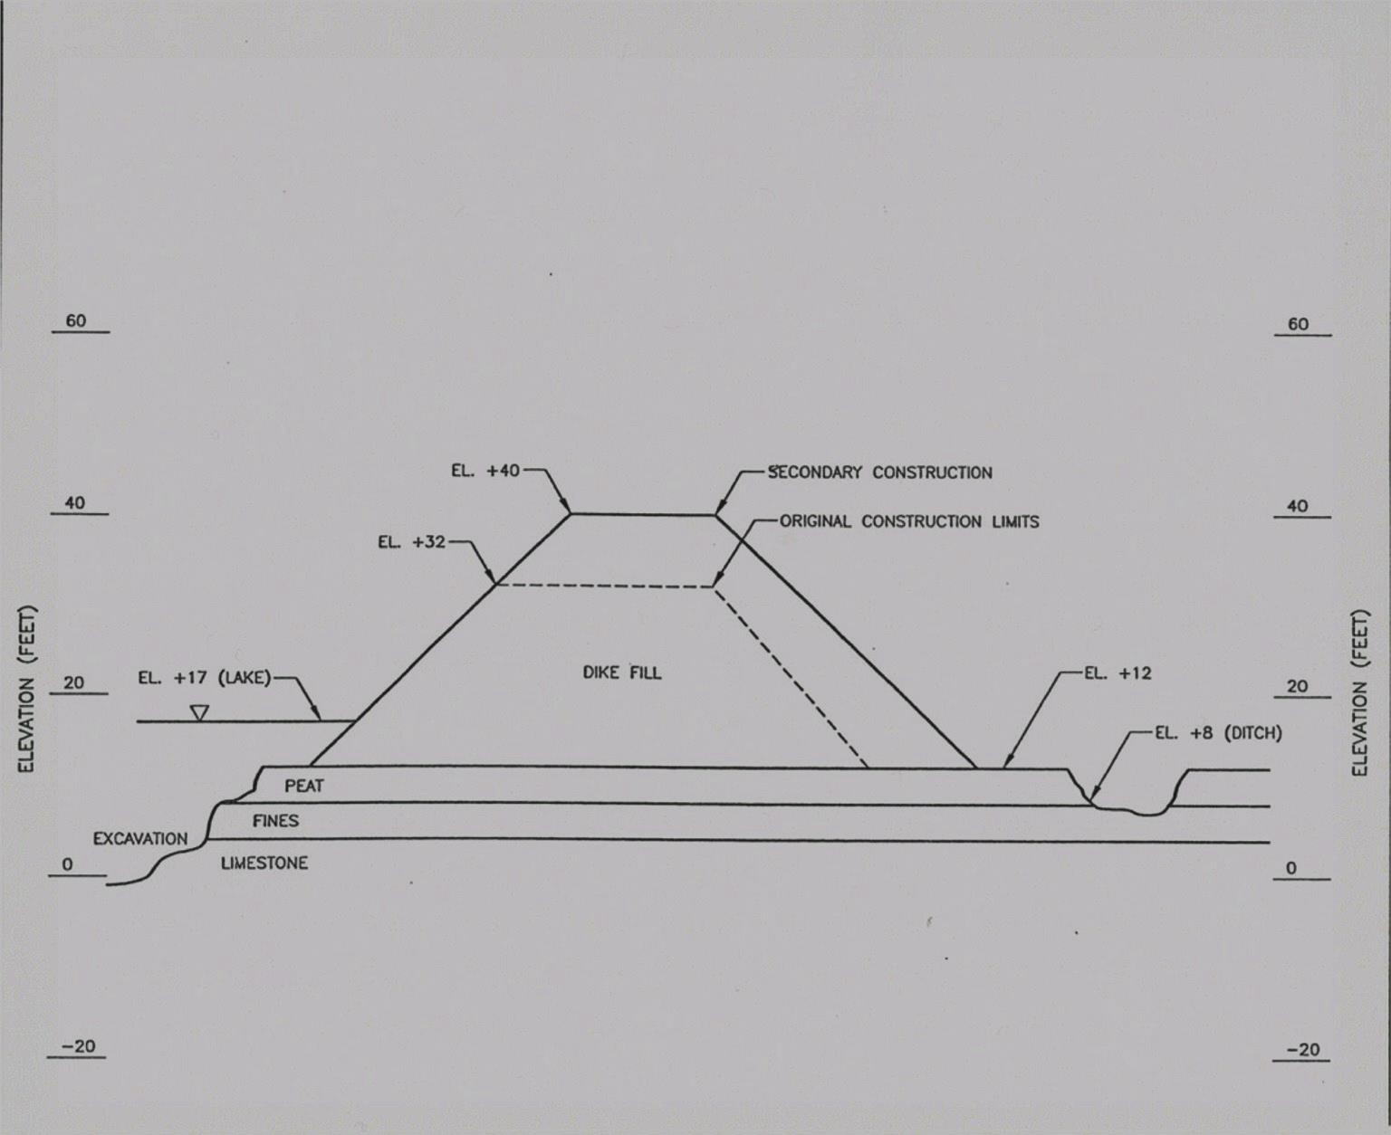
Typical Existing Cross-Section

Slide 53
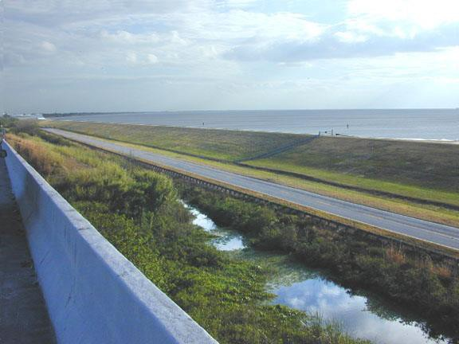
East Side of Lake Okeechobee

Slide 54
Herbert Hoover Dike
No selection of suitable materials
No compaction for suitable density
No seepage control through fill
No cutoff to prevent high pore pressures in landside slope and toe

Slide 55
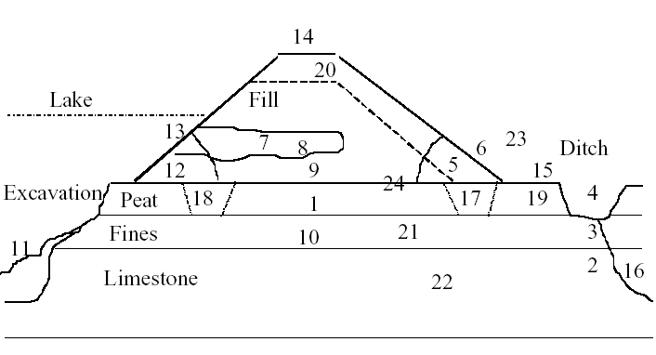
Problems Noted by USACE

Slide 56
Seepage Problems
During late summer 1995, the lake level reached
18.6 ft.
Excessive seepage was observed.
Sand boils and cloudy water at toe of dam.
Sinkholes appeared on the crest.

Slide 57
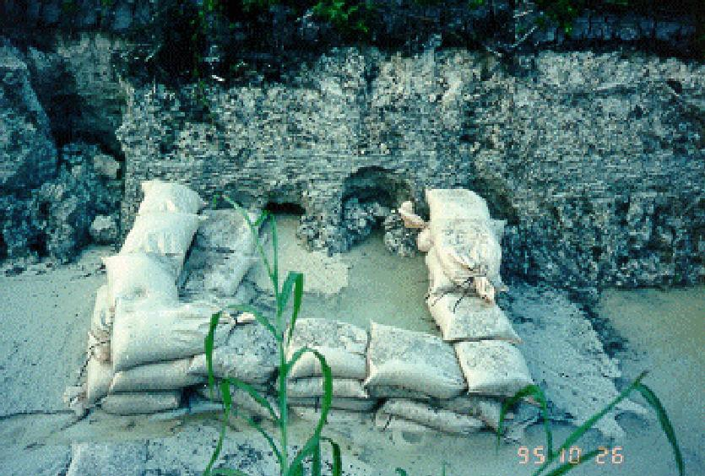
Sandbags Around Soil Pipes

Slide 58
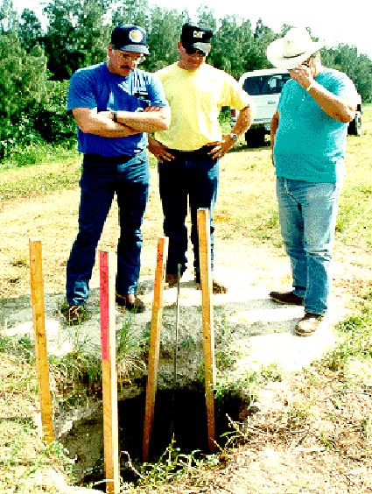
Sinkhole on Dam Crest
Lake Harbor

Slide 59
Seepage Problems
Following the 1995 event, seepage control berms, filters, and drains were installed at worst areas.
Surveillance increased to identify and repair
problem areas.
In March 1998, the lake rose to 18.5 feet.
Additional areas exhibited boils and excessive
seepage.

Slide 60
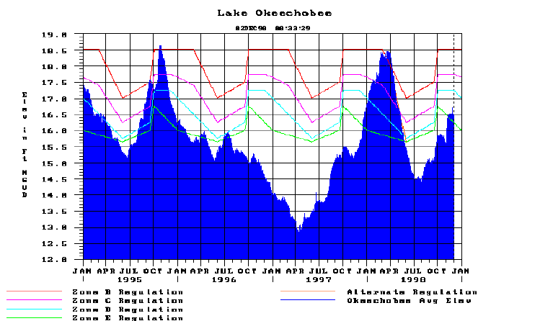
1995 and 1998 High Stages

Slide 61
1998 Review Panel
Expert panel convened by USACE to review
status of the HHD, included:
  Dr. Michael Duncan, John Bischoff, Dr. Thomas Wolff
  Dr. Ronald Hirschfeld, Dr. Hans Sellmeijer
The panel concluded that if the lake level had remained at 18.5 feet for an extended period, failure could have occurred.
Elev.18.5 level is a 30-year event.
Failure is “high probability” if lake reaches 21 feet.
Elev. 21 level is a 100-year event.

Slide 62
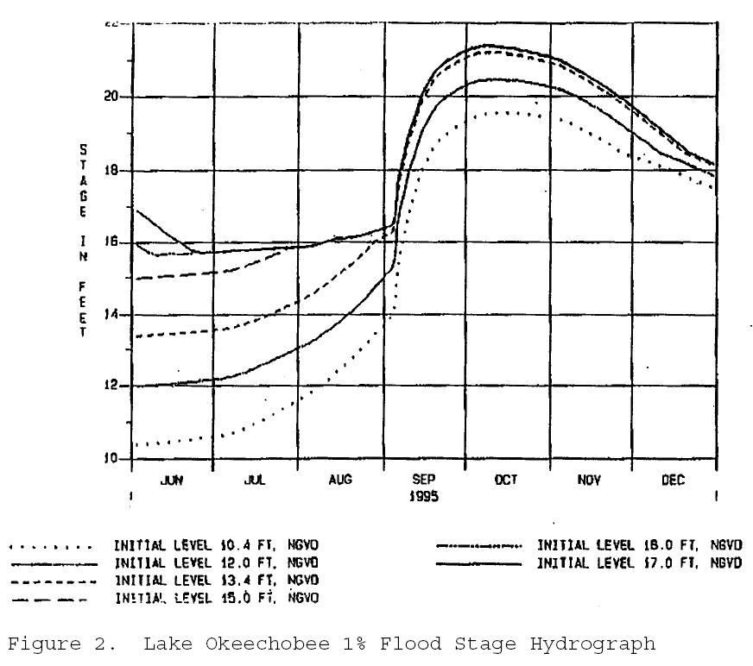
Lake Elevations for 100 Year Storm Event
(USACE, 2000)

Slide 63
USACE REGULATION 1110-8-2
DESIGN FLOODS
INFLOW DESIGN FLOODS FOR DAMS AND RESERVOIRS
5. General Policy. It is the Corps of Engineers policy that dams designed, constructed, or operated by the Corps will not create a threat of loss of life or inordinate property damage. Departures from accepted policy or practice will not be made in the design of a dam simply to reduce cost. Every phase of the planning, design, construction, and operation of a dam will be accomplished to assure that it is safe, efficient, and reliable.
6. Discussion.
b. The requirement that a dam failure must not present a hazard to human life remains a fixed condition that must be met by all designs.
7. Safety Dam Standards.
b. Standard 1: Standard 1 applies to the design of dams capable of placing human life at risk or causing a catastrophe, should they fail. Dam height with appropriate freeboard, spillways, regulating outlets, and structural designs will be such that the dam will safely pass an IDF computed from probable maximum precipitation (PMP) occurring over the watershed above the dam site.

Slide 64
Rehabilitation Plan (1999)
USACE proposed an extensive rehab program for HHD.
Beginning with critical SE 22 miles from Belle Glade to Port Mayaca
Construct downstream berm of pervious material
beginning at Elev. 28
Install relief trench into foundation soils

Slide 65
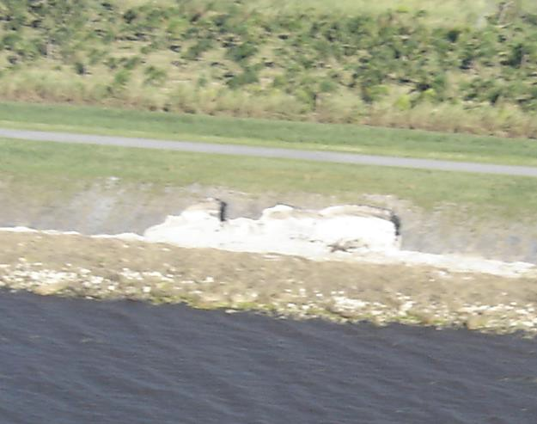
View of Wave Scarps

Slide 66

New Orleans August 30, 2005

Slide 67

Damage to the Flood Protection
System

Slide 68

Levee Wall Types

Slide 69

I-Wall Schematic

Slide 70

Distressed I-wall

Slide 71

Overturned I-wall

Slide 72

Overtopped Earth Embankment
During Storm Surge

Slide 73

Earth Levee

Slide 74

E Of Pointe a la Hache
Levee Breach

Slide 75

17th Street Levee Failure

Slide 76

Levee Failure Analysis

Slide 77
Hurricane Katrina References
Preliminary Report on Performance of the New Orleans Levee Systems, NSF, November 17, 2005
(www.asce.org/files/pdf/katrina/teamdatareport1121.pdf)
New Orleans Hurricane Protection Project
Data, IPET, January 10, 2006
(https://ipet.wes.army.mil/)

Slide 78
Independent Review Panel
Les Bromwell
  Geotechnical, Panel Chair
Robert Dean
  Hydrology, Hydrodynamics
Steve Vick
  Risk Analysis, Probability
Art Sengupta
  SFWMD Technical Investigation Manager

Slide 79
Review Panel Scope of Work
Review & Analysis of Documents and Data
Dike Stability Evaluation
Wind and Precipitation Analyses
Preparation of Evaluation Report by April 30, 2006

Slide 80

Review Panel Site Inspection
January 13, 2006

Slide 81

Wright’s Lake Dam, Clay Cnty

Slide 82

Pensacola Dam Failure

Slide 83

Pensacola

Slide 84

Blue Springs Ave.

Slide 85

Blue Springs Ave. at 2 am

Slide 86
CERP Reservoirs
70,000 Acres of Reservoirs Planned
Dam Heights Ranging 15-30 feet
Constructed to Modern Safety Standards
  Will include positive seepage control features
  Will include foundation improvement features
  Will have adequate freeboard for storm surges
  Will have emergency discharge provisions
Will be expensive structures!

Slide 87
CERP RESERVOIRS
--DESIGN CRITERIA
Freeboard must accommodate most severe of 4 extreme wind and precipitation conditions
  PMP + 100-year wind
  100-yr precipitation + Category 5 winds
  PMW + Full Reservoir Level
  Hurricane Easy (Cat 3 + 38.7 inches rain)
Positive seepage control required
  Slurry cut-off wall
  Filters & Drains of non-carbonate sand/gravel
Interior slopes protected against wave erosion
  Soil Cement
  Roller-Compacted Concrete
  Rip-Rap

Slide 88
Florida’s Aging Infrastructure
C&SF Facilities Mostly 50+ Years Old
Maintenance Costs Increasing
Risk of Failures Is Increasing
What is the Plan for Replacement?
What will it Cost?
Where Will the Funding Come From?

